Slide 1
Data Analytics (CMP330)
Dr. David Glass
School of Computing
dh.glass@ulster.ac.uk
Week 4 – Introduction to normal distribution and probability density functions using R
ulster.ac.uk

Slide 2
Week 4
Content
Random variables
Discrete probability distribution
Cumulative probability & Continuous probability distribution
Central limit theorem
Normal distribution
Cumulative distribution function
Z-scores and standardisation
Binomial Distribution
Poisson Distribution

Slide 3
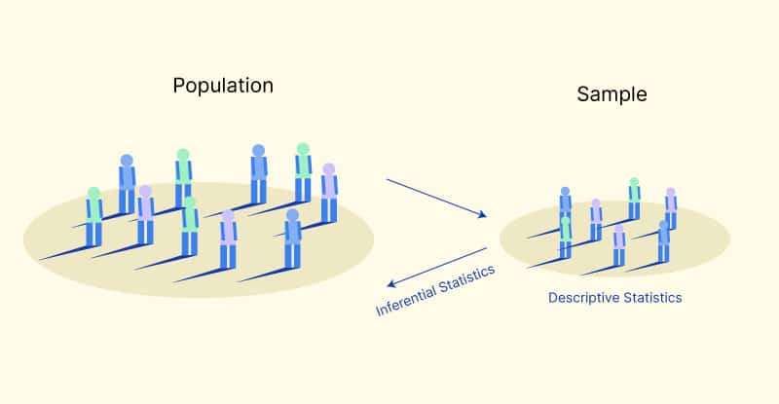
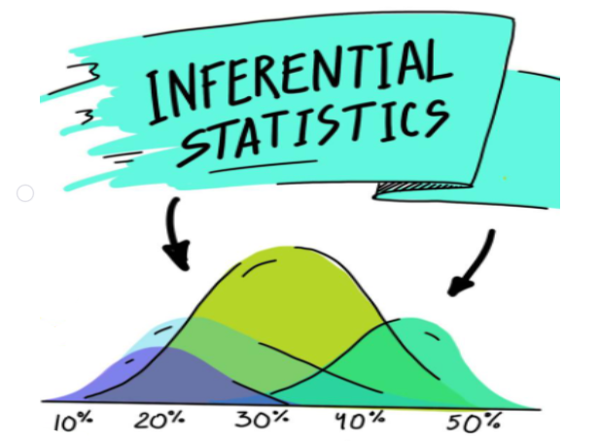
Inferential statistics
Inferential statistics deals with the process of inferring information about a population based on a sample from that population.
https://www.voxco.com/blog/inferential-statistic-whats-and-hows/

Slide 4
Inferential statistics
In inferential statistics, we will discuss probability, distributions, and hypothesis testing.
Inference is about making assumptions about the way data is distributed, try to fit it in a known distribution applying some type of transformation. That’s why we need to introduce some theoretical probability distributions with known properties.
If the actual distribution of a given data set is reasonably close to that of a theoretical probability distribution, many calculations can be performed on the actual data by using assumptions drawn from the theoretical distribution.
https://ai.plainenglish.io/inferential-statistics-probability-distributions-65b410ad5aef

Slide 5
Probability theory
Probability is a measure of the chance of occurrence of a phenomenon. Important terms in Probability:
Random Experiment: All the possible outcomes of the experiments are already known. The experiment can be repeated numerous times under identical or similar conditions.
Sample space: Sample space of a random experiment is the collection of all the possible outcomes of a random experiment.
Event: A subset of sample space is called an event.
Trial: Trial refers to a special type of experiment in which we have two types of possible outcomes: success or failure with varying Success probability.
https://ai.plainenglish.io/inferential-statistics-probability-distributions-65b410ad5aef

Slide 6

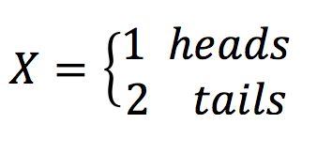
Probability theory
Random variables
A random variable, usually written X, is a variable whose possible values are numerical outcomes of a random phenomenon
Two types:
Discrete (e.g. number of students in a class)
Continuous (e.g. height, weight, distance)
P(X = 1) = 0.5
P(X = 2) = 0.5
http://www.stat.yale.edu/Courses/1997-98/101/ranvar.htm

Slide 7
Probability distribution
“A probability distribution is… an equation that links each outcome of a statistical experiment with its probability of occurrence.”
It is the mathematical function describing the randomness of a random variable.
For instance, if X is used to denote the outcome of a coin toss ("the experiment"), then the probability distribution of X would take the value 0.5 (1 in 2 or 1/2) for X = heads, and 0.5 for X = tails (assuming that the coin is fair).
http://stattrek.com/probability-distributions/probability-distribution.aspx
https://www.mygreatlearning.com/blog/inferential-statistics-an-overview/

Slide 8
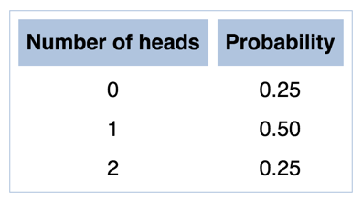
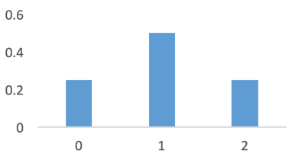
Discrete Probability Distribution
Suppose you flip a coin 2 times.
Possible outcomes: HH, HT, TH and TT
Probability distribution of the number of heads?
http://stattrek.com/probability-distributions/probability-distribution.aspx

Slide 9
Cumulative probability
“A cumulative probability refers to the probability that the value of a random variable falls within a specified range.”
Probability that 2 coin flips includes 1 or fewer heads?
P(X ≤ 1) = P(X = 0) + P(X = 1)
= 0.25 + 0.50 = 0.75
https://stattrek.com/statistics/dictionary.aspx?definition=cumulative_probability

Slide 10
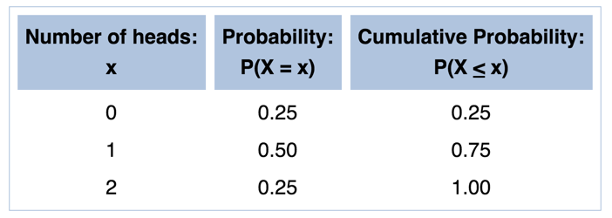
Cumulative probability

Slide 11
Continuous random variables
Height, weight, distance, time etc.
Computer is a discrete system
Can it truly represent continuous variables?
So how do we work with continuous variables and their distributions?

Slide 12
Quantisation of continuous variables
Range = max – min
Number of intervals: Not less than 10 and no more than 20
Step interval size = range / number of intervals
Or
*Intervals are also known as bins

Slide 13

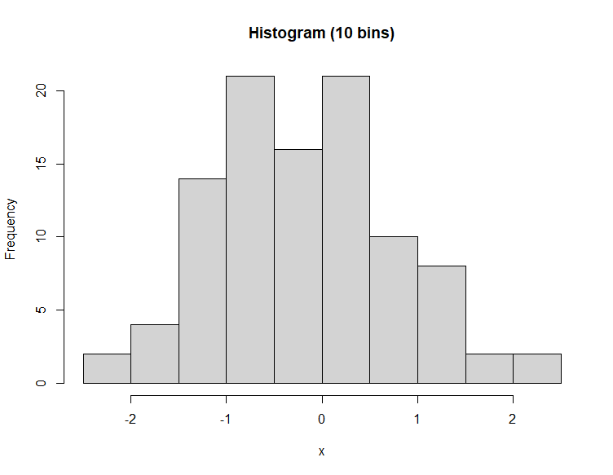
Quantisation of continuous variables
Histograms can change depending on the number of bins

Slide 14
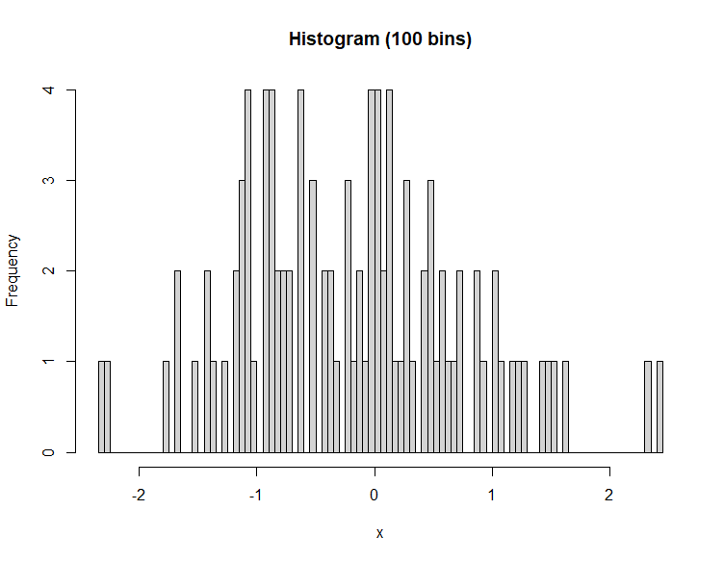
Quantisation of continuous variables
Histograms can change depending on the number of bins

Slide 15
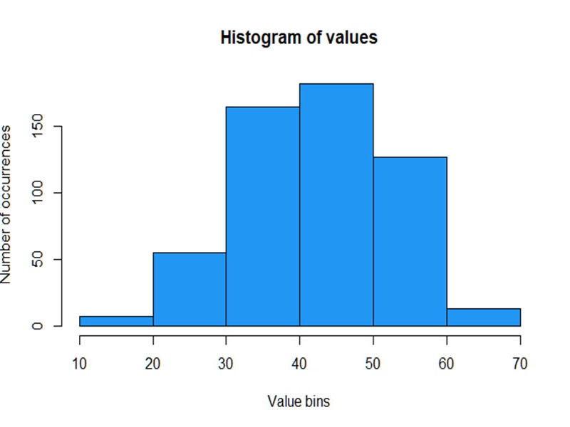
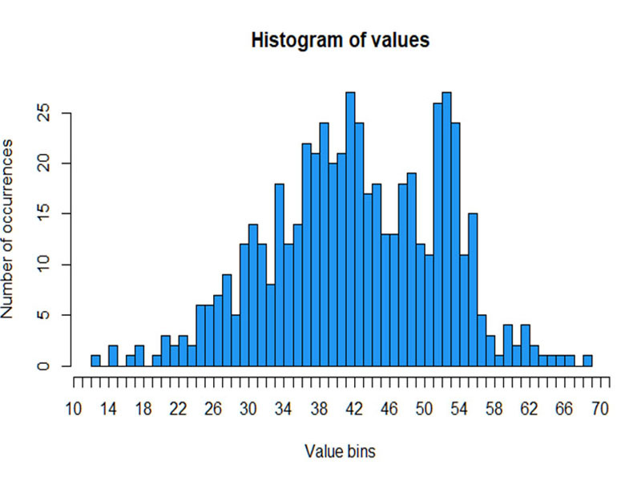
Quantisation of continuous variables
How to Bin a Histogram?
Bins that are too wide can hide important details about distribution.
Bins that are too narrow can cause a lot of noise and hide important information about the distribution as well.
Too-wide: Too wide bins, unable to detect unusual spike at around 53
Too-narrow: Too narrow bins, there are lots of spikes just by coincidence

Slide 16
Quantisation of continuous variables
Computing Bin size
Square-root choice
Sturges' formula
If n was 8 then k = 4
If n was 16 then k = 5
Freedman-Diaconis
Rice
Scott
…

Slide 17
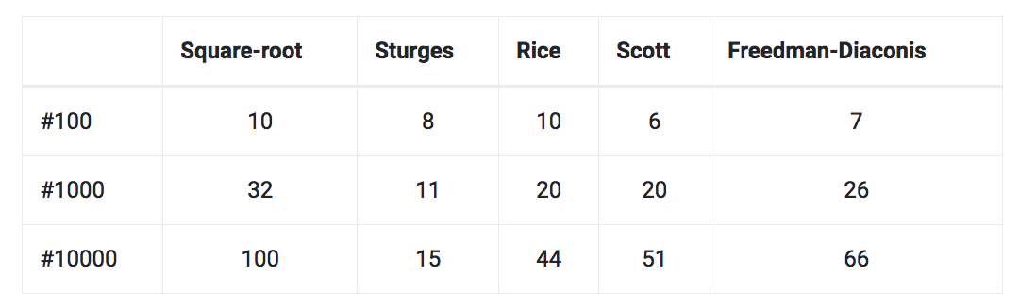
Quantisation of continuous variables
Computing Bin size
Normally distributed numbers with mean 50 and standard deviation 10
Number of bins computed

Slide 18
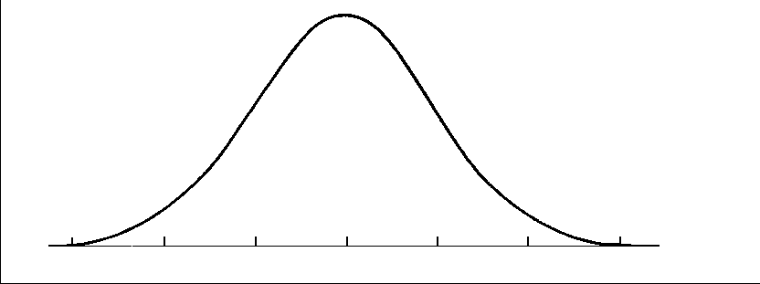
Continuous Probability Distribution
Distribution of times it took you to drive to work (average=50, SD=20)
What is the probability that it will take you 50 minutes?
P(Y = 50)
50

Slide 19
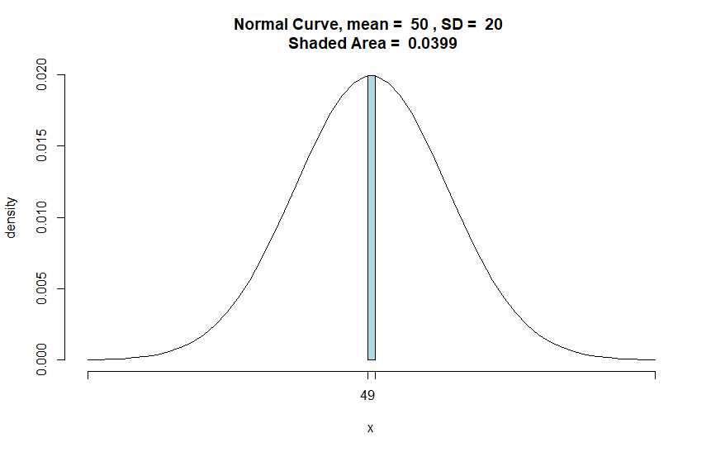
Continuous Probability Distribution
Distribution of times it took you to drive to work (average=50, SD=20)
P(49 < Y < 51)
tigerstats R package
library("tigerstats")
?pnormGC
pnormGC( c(49,51), region="between", mean=50, sd=20, graph=TRUE )

Slide 20
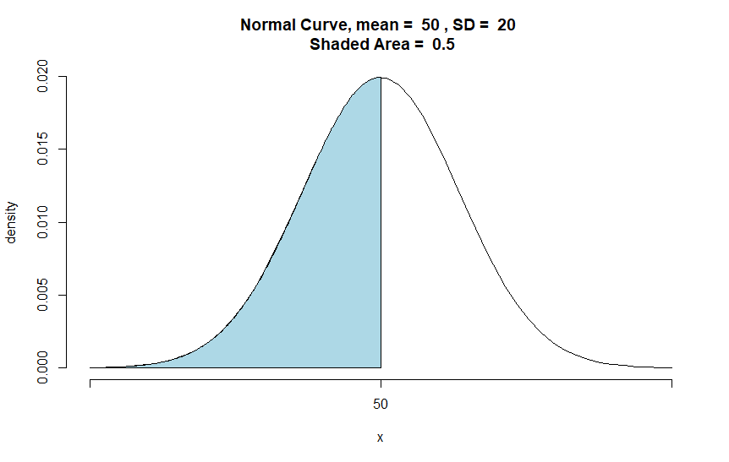
Continuous Probability Distribution
What is the probability that it will take you less than 50 minutes?
- P(Y < 50)
pnormGC(c(50), region="below", mean=50, sd=20, graph=TRUE)

Slide 21
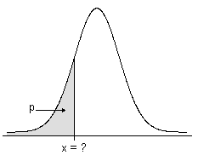
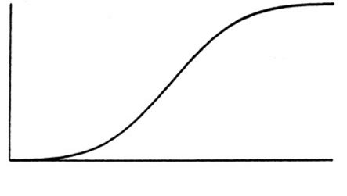
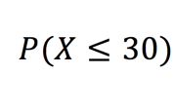
Cumulative distribution function (CDF)
mean=50, SD=20
= 0.21
x = 30

Slide 22
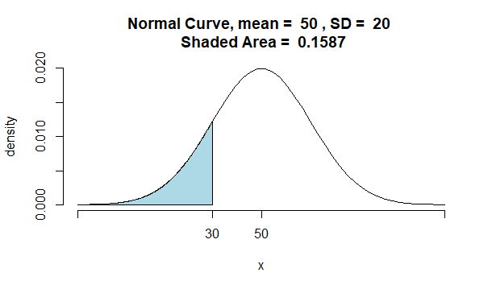
Cumulative distribution function (CDF)
pnormGC(c(30), region="below", mean=50, sd=20, graph=TRUE)

Slide 23

Cumulative distribution function (CDF)
pnorm()
The pnorm function gives the Cumulative Distribution Function (CDF) of the Normal distribution in R, which is the probability that the variable X takes a value lower or equal to x.
Using pnorm to find percent less than a value
pnorm(q, mean, sd)
pnorm(30, 50, 20)
pnorm(q=30, mean=50, sd=20)

Slide 24

Cumulative distribution function (CDF)
pnorm()
Using pnorm to find percent greater than a value.
pnorm(q, mean, sd, lower.tail = FALSE)

Slide 25
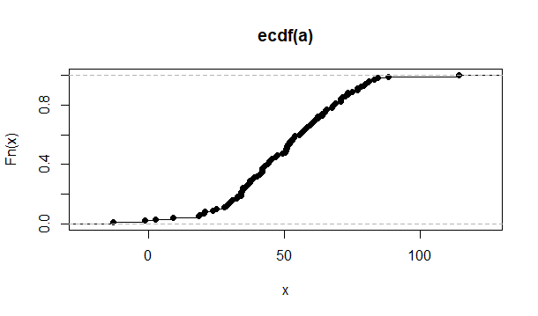
Cumulative distribution function (CDF)
ecdf()
Use built-in function ecdf to plot cdf
a <- rnorm(100, 50,20) # create a 100 sample vector whose mean=50 and sd=20
plot(ecdf(a)) # plot cdf

Slide 26
Central limit theorem
Quote - “If the sample is large (n>=30) then statistical theory says that the sample mean is normally distributed... This is a result of a famous statistical theorem, the Central limit theorem.”
Central limit theorem states that when a sufficiently large number of samples drawn from independent random variables, the arithmetic mean of their distributions will behave like a normal distribution, commonly known as a bell-shaped distribution.
https://www.value-at-risk.net/central-limit-theorem/

Slide 27
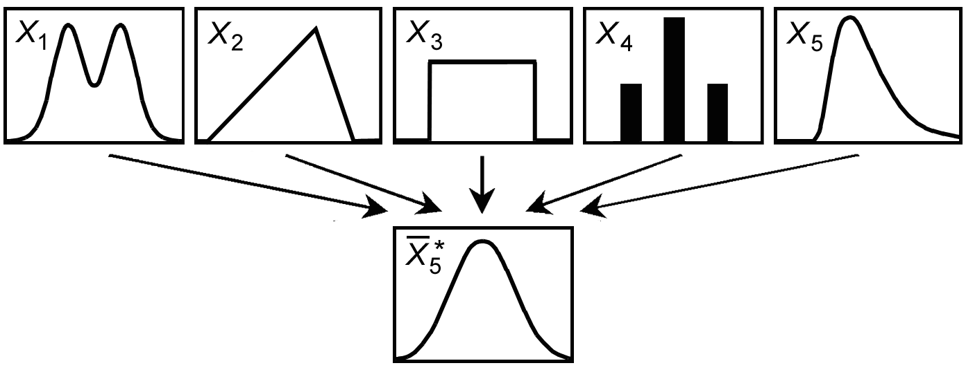
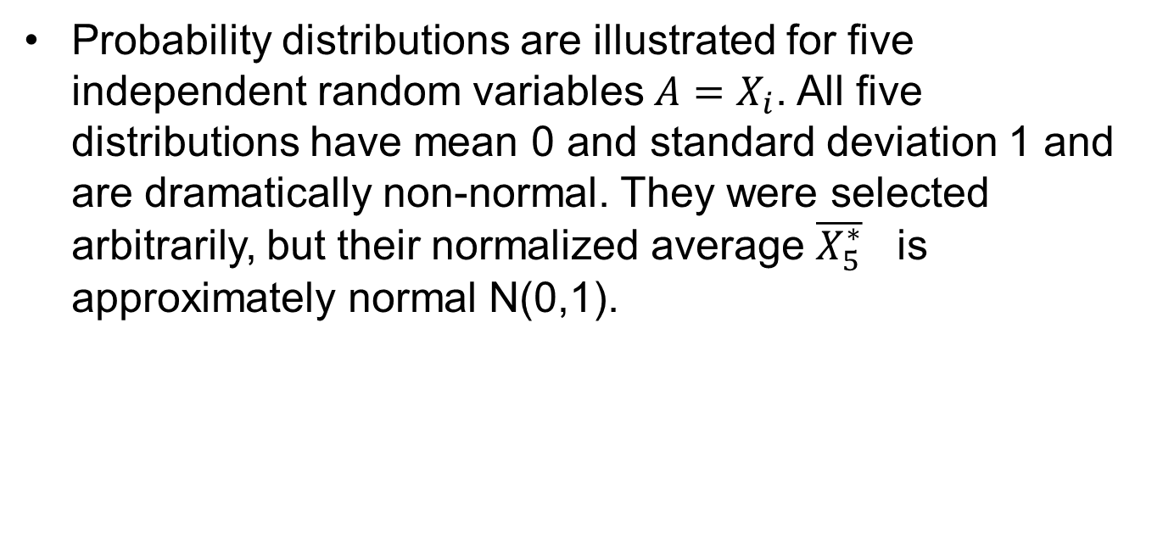
Central limit theorem
Probability distributions are illustrated for five independent random variables $A=X_{i}$. All five distributions have mean 0 and standard deviation 1 and are dramatically non-normal. They were selected arbitrarily, but their normalized average $\overline{X_{5}^{∗}}$ is approximately normal N(0,1).
https://www.value-at-risk.net/central-limit-theorem/

Slide 28

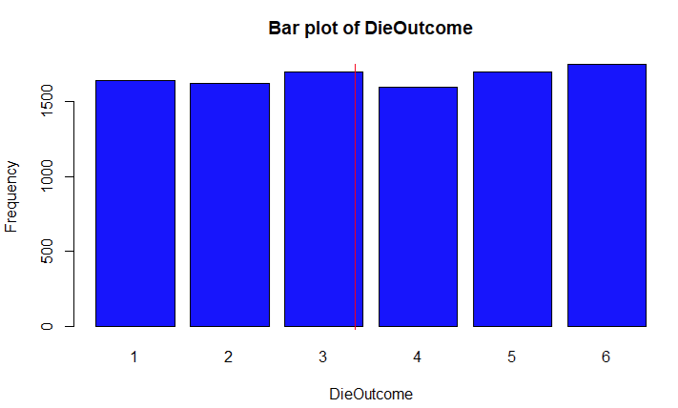
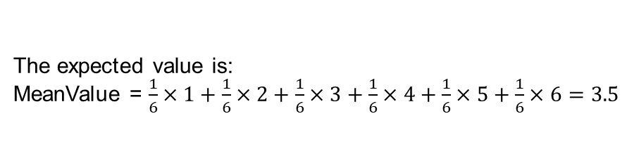
Central limit theorem
Example – A fair die
A fair die can be modelled with a discrete random variable with outcome 1 through 6, each with the equal probability of 1/6.
The expected value is:
MeanValue = $\frac{1}{6}×1+\frac{1}{6}×2+\frac{1}{6}×3+\frac{1}{6}×4+\frac{1}{6}×5+\frac{1}{6}×6=3.5$
Suppose you throw the die 10000 times and plot the frequency of each outcome.
https://rpubs.com/ranjeetapegu/Central-Limit-Theorem .

Slide 29
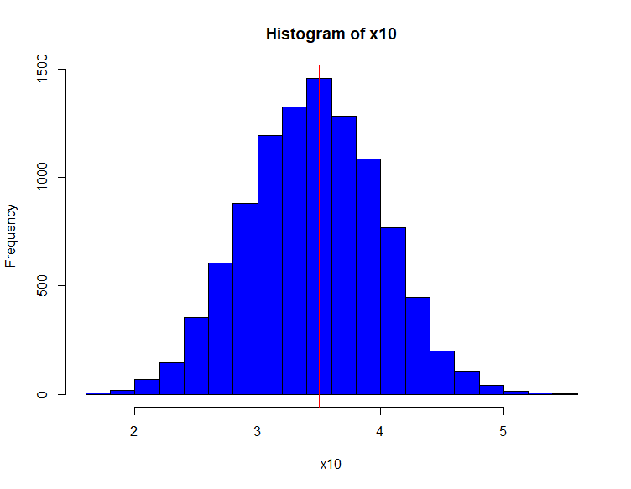

Central limit theorem
Example – A fair die
Take samples of size 10 from the previous 10000 observation of outcome of die roll
Take the arithmetic mean and try to plot the mean of sample.
Do this procedure k times (in this case k= 10000 )
https://rpubs.com/ranjeetapegu/Central-Limit-Theorem .

Slide 30
Normal distribution
Definition
Normal distribution is a probability distribution that is symmetric about the mean, showing that data near the mean are more frequent in occurrence than data far from the mean. In graph form, normal distribution will appear as a bell curve.
https://www.investopedia.com/terms/n/normaldistribution.asp

Slide 31
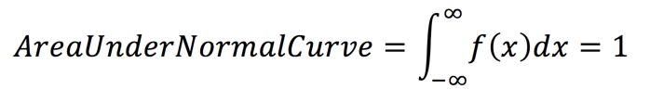
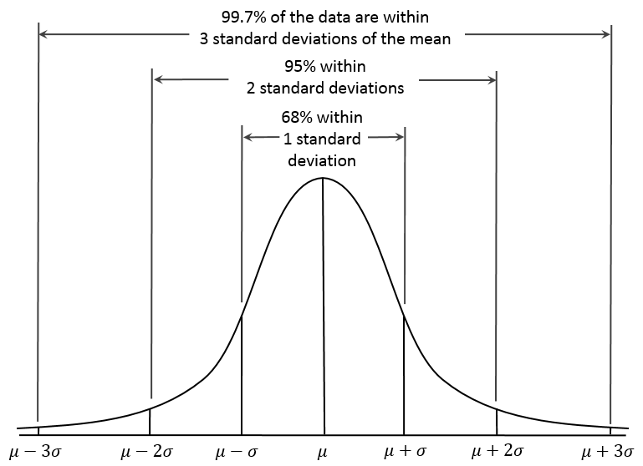
Normal distribution
https://commons.wikimedia.org/wiki/File:Empirical_Rule.PNG

Slide 32

Standardization and Z-Scores
Z ~ N(0, 1)
A z-value is used to standardise a number so that it becomes ‘metric agnostic’
Z-values then can be summed with z-values derived from other metrics to create a composite score.

Slide 33
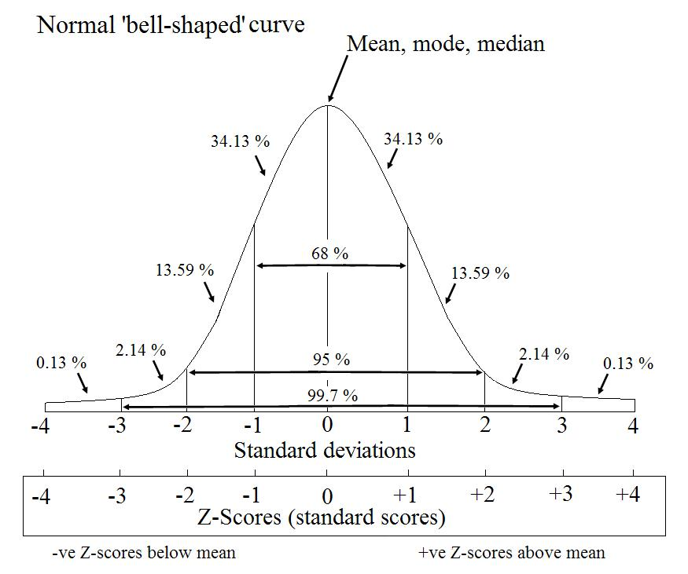
Standardization and Z-Scores
Z ~ N(0, 1)
Mean=0, standard deviation=1.
Standard Normal Distribution and Standard Score (z-score)

Slide 34
Z-scores
Z-score is a very useful statistic
can be used to calculate the probability of a score occurring within our normal distribution
enable us to compare two scores that are from different normal distributions.
Problem with z-scores
From –infinity to +infinity
Confusing

Slide 35
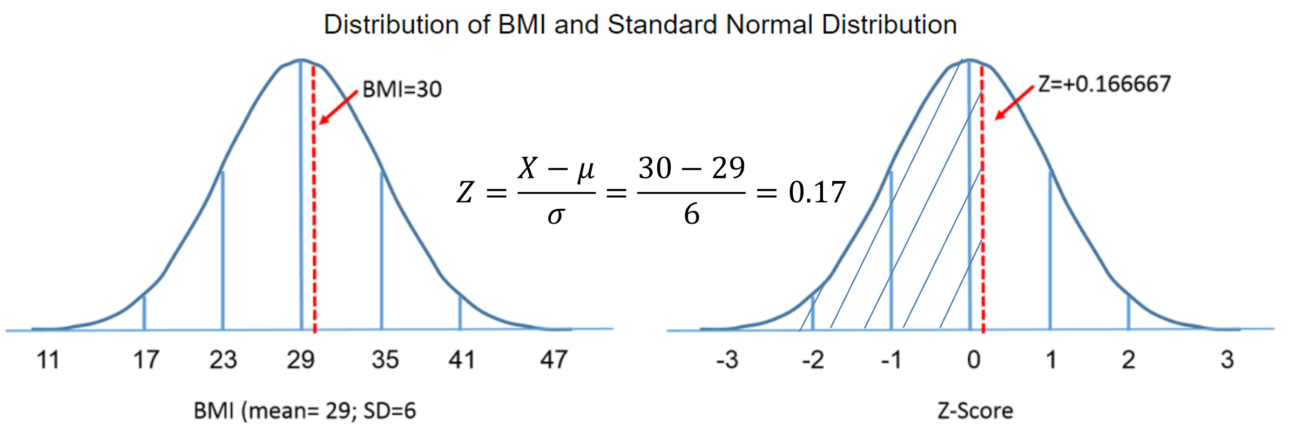
Z-scores
Example
For any given Z-score we can compute the area under the curve to the left of that Z-score. The figures below show the distributions of BMI for men aged 60 and the standard normal distribution side-by-side.

Slide 36



Z-scores
Example
What is the probability that a 60 year old man will have a BMI less than 30? The Z-score was 0.16667.
Check the table Z score table:
P(X < 30) = 0.56749 = 56.75%

Slide 37
T scores
All positive scores
Divide distribution into 100 equal parts
0 = 5 SDs below the mean
100 = 5 SDs above the mean
10 Z + 50

Slide 38
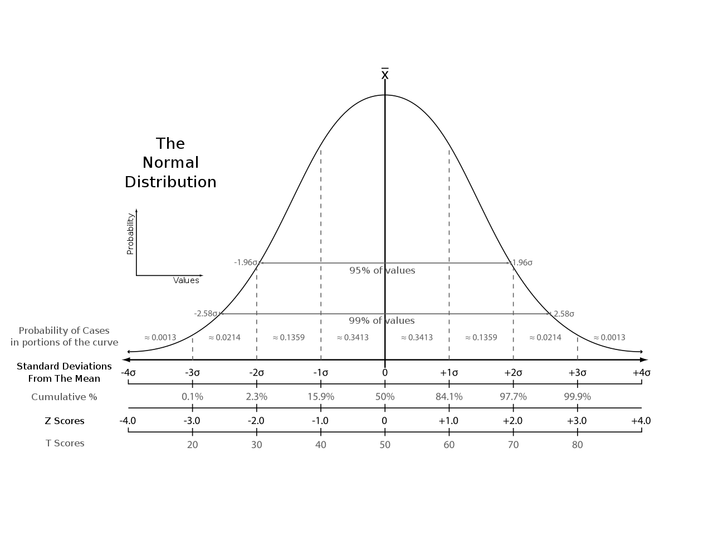
Z Scores vs T Scores

Slide 39
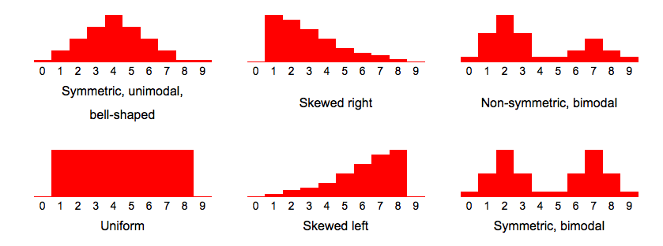
Different distributions
http://stattrek.com/statistics/charts/data-patterns.aspx?Tutorial=AP

Slide 40
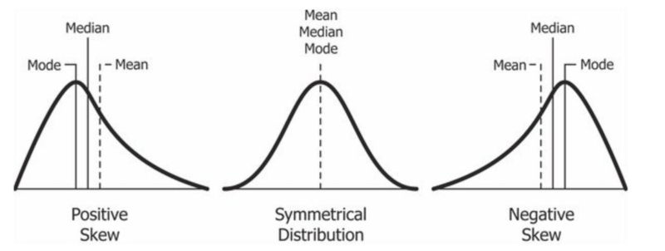
Distribution measures
Skewness
Example – what about salary distribution
E.g. mean is a bad measure of the distribution if the variable is skewed

Slide 41
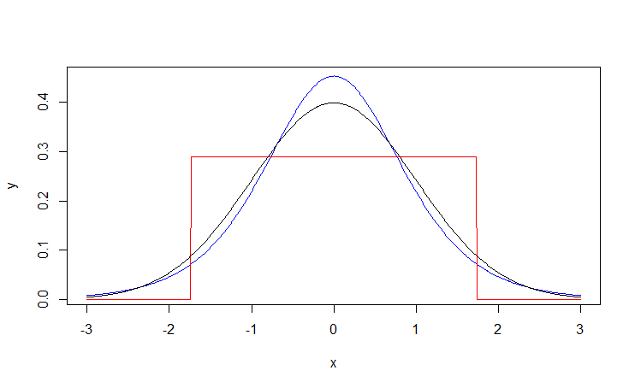
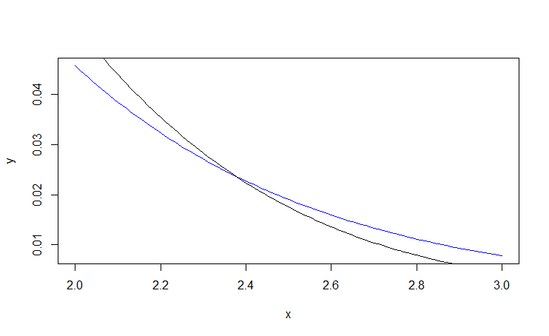
Distribution measures
Kurtosis
Measure of the tailedness
Kurtosis of a normal distributed variable is 3.
Distributions with kurtosis less than 3 (negative excess kurtosis) are said to be platykurtic
Distributions with kurtosis greater than 3 (positive excess kurtosis) are said to be leptokurtic.
Leptokurtic
Normal /
Mesokurtic
Platykurtic

Slide 42
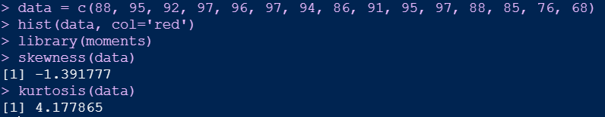
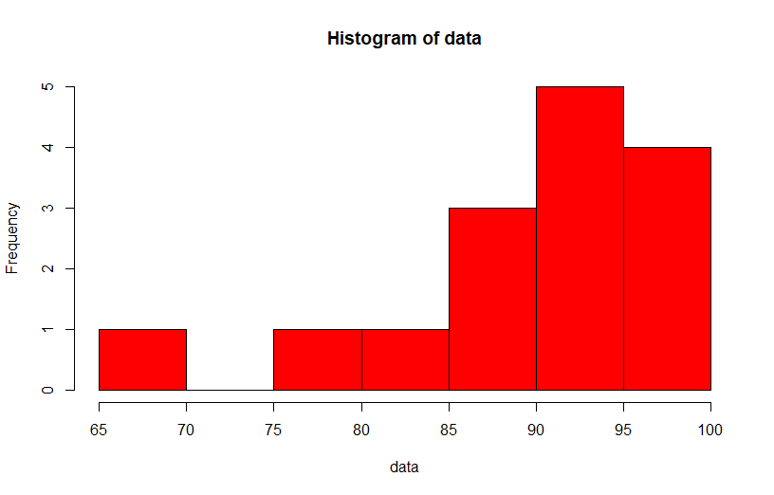
Measures of skewness and kurtosis
R function
library(moments)
skewness() # calculate skewness
kurtosis() #calculate kurtosis
https://www.statology.org/skewness-kurtosis-in-r/

Slide 43
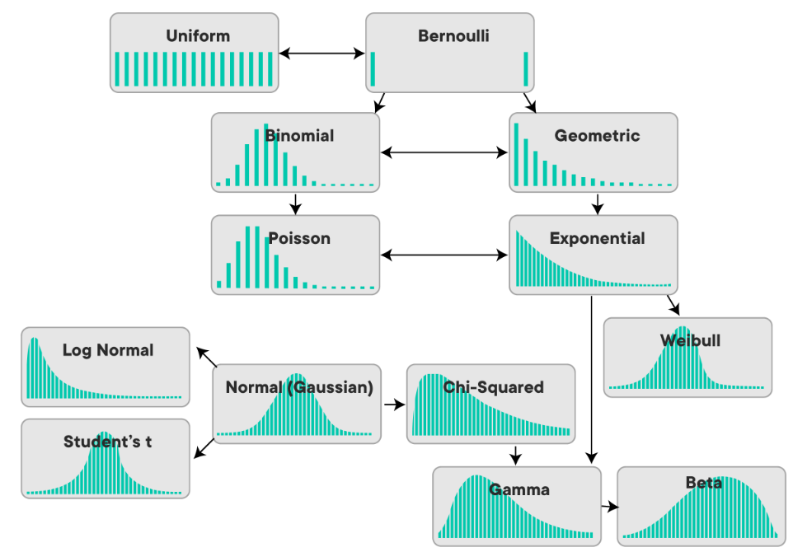
Types of distributions
Normal (Gaussian)
Chi-square
Uniform
Beta
Gamma
Poisson
Exponential
Log
https://medium.com/mytake/understanding-different-types-of-distributions-you-will-encounter-as-a-data-scientist-27ea4c375eec

Slide 44
Normal Distribution R Functions
For normal distributions, R provides four different functions:
A density function
dnorm(x, mean = 0, sd = 1, log = FALSE)
A distribution or probability function
pnorm(q, mean = 0, sd = 1, lower.tail = TRUE, log.p = FALSE)
A quantile function
qnorm(p, mean = 0, sd = 1, lower.tail = TRUE, log.p = FALSE)
A random number generator
rnorm(n, mean = 0, sd = 1)

Slide 45
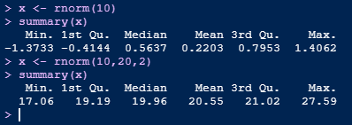
Generating a Normal Distribution of a Random Variable
?rnorm

Slide 46
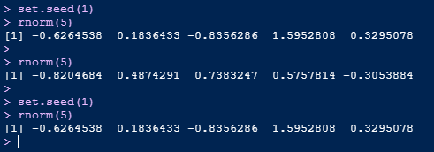
Setting the seed
Creating simulations or random objects that can be reproduced

Slide 47
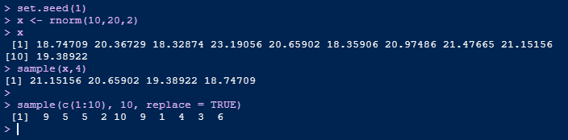
Random Sampling - Bootstrapping
Take samples of data: sample()

Slide 48
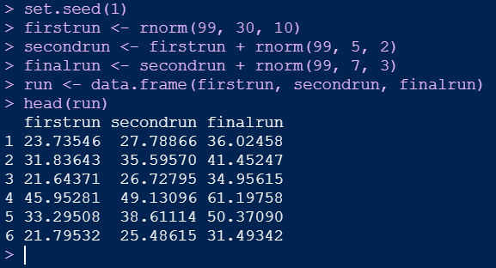
Exercise!
Generate a vector of random numbers which are normally distributed.

Slide 49


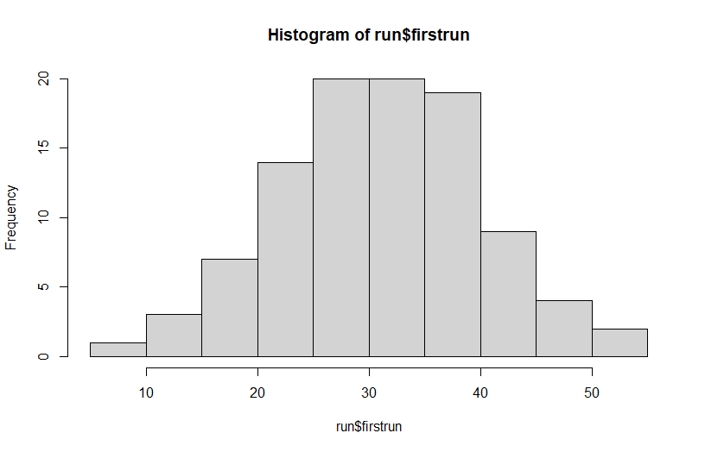
Exercise!

Slide 50

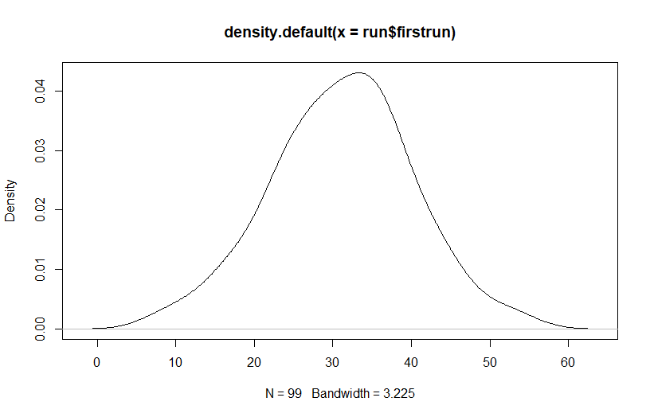
Exercise!
Density plot

Slide 51
Exercise!
Normality Testing
Shapiro-Wilk test of normality.
Hypothesis test
H0 = Null hypothesis: Data is normally distributed
H1 = Alternative hypothesis: Data is not normally distributed

Slide 52
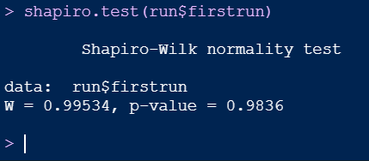
Exercise!
Normality Testing
Shapiro-Wilk test of normality.
shapiro.test(run$firstrun)
p-value > 0.05 implying that the distribution of the differences are not significantly different from normal distribution. In other words, we can assume the normality.

Slide 53

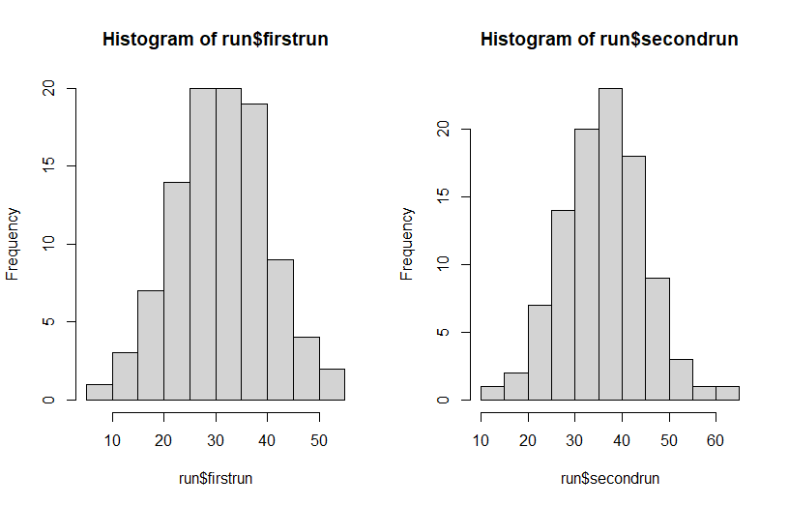
Exercise!
Histogram

Slide 54
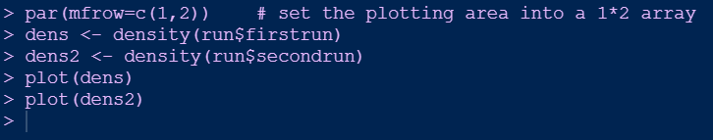
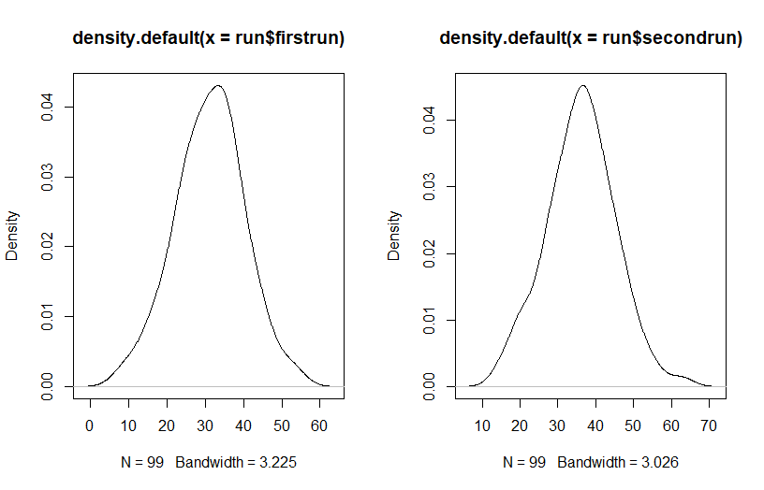
Exercise!
Density plot

Slide 55
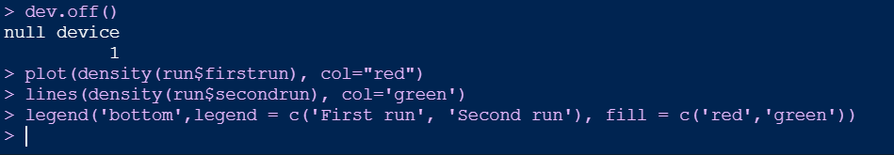
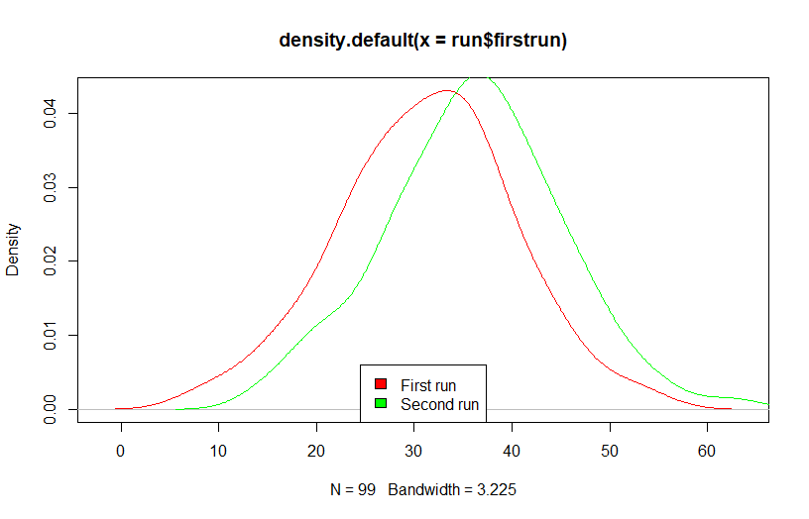
Exercise!
Density plot

Slide 56

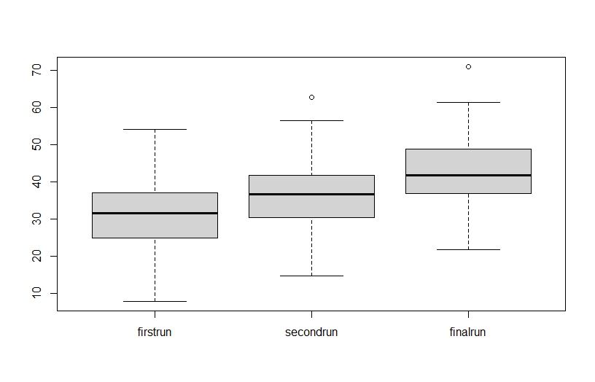
Exercise!
Boxplot

Slide 57

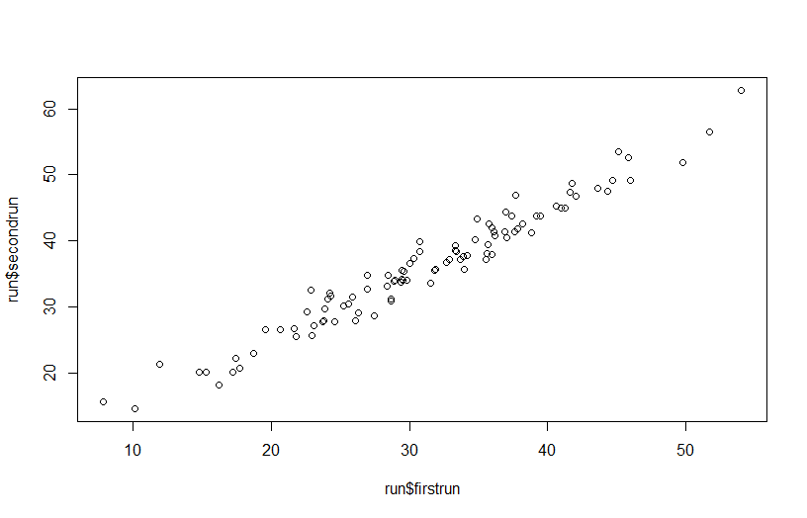
Exercise!
Scatter plot

Slide 58

Exercise!
Measures of skewness and kurtosis
library(moments)
skewness()
kurtosis()
https://www.r-bloggers.com/measures-of-skewness-and-kurtosis/

Slide 59


Exercise!
Measures of skewness and kurtosis

Slide 60


Exercise!
Measures of skewness and kurtosis
10000 samples from a normal distribution with mean 55, and standard deviation 4.5

Slide 61

Binomial Distribution
Definition
The binomial distribution is a discrete probability distribution. It describes the outcome of n independent trials in an experiment.
Each trial is assumed to have only two outcomes, either success or failure.
If the probability of a successful trial is p, then the probability of having x successful outcomes in an experiment of n independent trials is as follows:
$f\left(x\right)=\left({n \atop x}\right)p^{x}{(1−p)}^{(n−x)}$ where $x=0, 1, 2, …, n$
http://www.r-tutor.com/elementary-statistics/probability-distributions/binomial-distribution

Slide 62

Binomial Distribution
R function dbinom() gives the probabilities for various values of the binomial variable.
Probability of getting the number of heads (0, 1, 2, 3…50) while tossing a coin 50 times

Slide 63


Binomial Distribution
Note that the binomial distribution is symmetric when p = 0.5.
Will the binomial distribution be negatively skewed when p is larger than 0.5?

Slide 64


Binomial Distribution
Will the binomial distribution be positively skewed when p is smaller than 0.5?

Slide 65
Binomial Distribution
Example
R function to generate random data from binomial distribution
Tossing a coin: Probability of getting the number of heads (0, 1, 2, 3…50) while tossing a coin 50 times; Here, the random variable X is the number of “successes” that is the number of times heads occurs. The probability of getting a heads is 1/2. Binomial distribution could be represented as B(50,0.5). The diagram below represents the binomial distribution for 10,000 experiments
rbinom(n = number of repetitions = 10,000, size = sample size = 50, p = the probability of success (chance of throwing heads is 0.5))

Slide 66

Binomial Distribution
Example

Slide 67
Binomial Distribution
More Examples
Defective Items: Probability of finding the number of defective items (0, 1, 2, 3…30) while examining 30 times; Here, the random variable X is the number of “successes” that is the number of times defective item is found out. The probability of finding a defective item is p. Binomial distribution could be represented as B(30,p)
A person infected with Covid-19: Probability of finding 0 or more number of people infected with Covid-19 while examining 30 people; Here, the random variable X is the number of “successes” that is the number of people found to be infected with corona virus. The probability of finding a person infected with corona virus says, p. The binomial distribution could be represented as B(30,p)

Slide 68

Binomial Distribution
Normal Approximation to Binomial Distributions
The Central Limit Theorem says that as n increases, the binomial distribution with n trials and probability p of success gets closer and closer to a normal distribution with mean $μ=np$ and standard deviation $\sqrt{np(1−p}$.
http://digitalfirst.bfwpub.com/stats_applet/generic_stats_applet_2_cltbinom.html

Slide 69

Poisson Distribution
Definition
The Poisson distribution is the probability distribution of independent event occurrences in an interval.
If λ is the mean occurrence per interval, then the probability of having x occurrences within a given interval is:
$f(x)=\frac{λ^{x}e^{−λ}}{x!}$ where $x=0, 1, 2, 3, …$
http://www.r-tutor.com/elementary-statistics/probability-distributions/poisson-distribution

Slide 70
Poisson Distribution
R functions
For Poisson distributions, R provides four different functions:
Poisson probability function
dpois()
Poisson distribution (Cumulative distribution function)
ppois()
Poisson quantile function
qpois()
Poisson random number generator
rpois()

Slide 71


Poisson Distribution
Plot of the Poisson probability function in R
For example, suppose a given website receives an average of 5 visitors per hour. What is the probability distribution for the number of visitors that the website receives per hour?
https://r-coder.com/poisson-distribution-r/

Slide 72


Poisson Distribution
Plot of the Poisson probability function in R
Poisson probability distribution of different λ
https://r-coder.com/poisson-distribution-r/

Slide 73


Poisson Distribution
Example
If there are 50 customers arrive at the restaurant per hour on average, find the probability of having 60 or less customers arrive at the restaurant in a particular hour.
Use the function ppois()
find the probability of having 45 or more customers arrive at the restaurant in a particular hour.

Slide 74
Further reading
https://www.r-bloggers.com/normal-distribution-functions/
https://www.r-bloggers.com/measures-of-skewness-and-kurtosis/
http://www.r-tutor.com/elementary-statistics/probability-distributions
Ott, R.L. and Longnecker, M.T., 2015. An introduction to statistical methods and data analysis. Cengage Learning.(Chapter 4)

